Slide 1
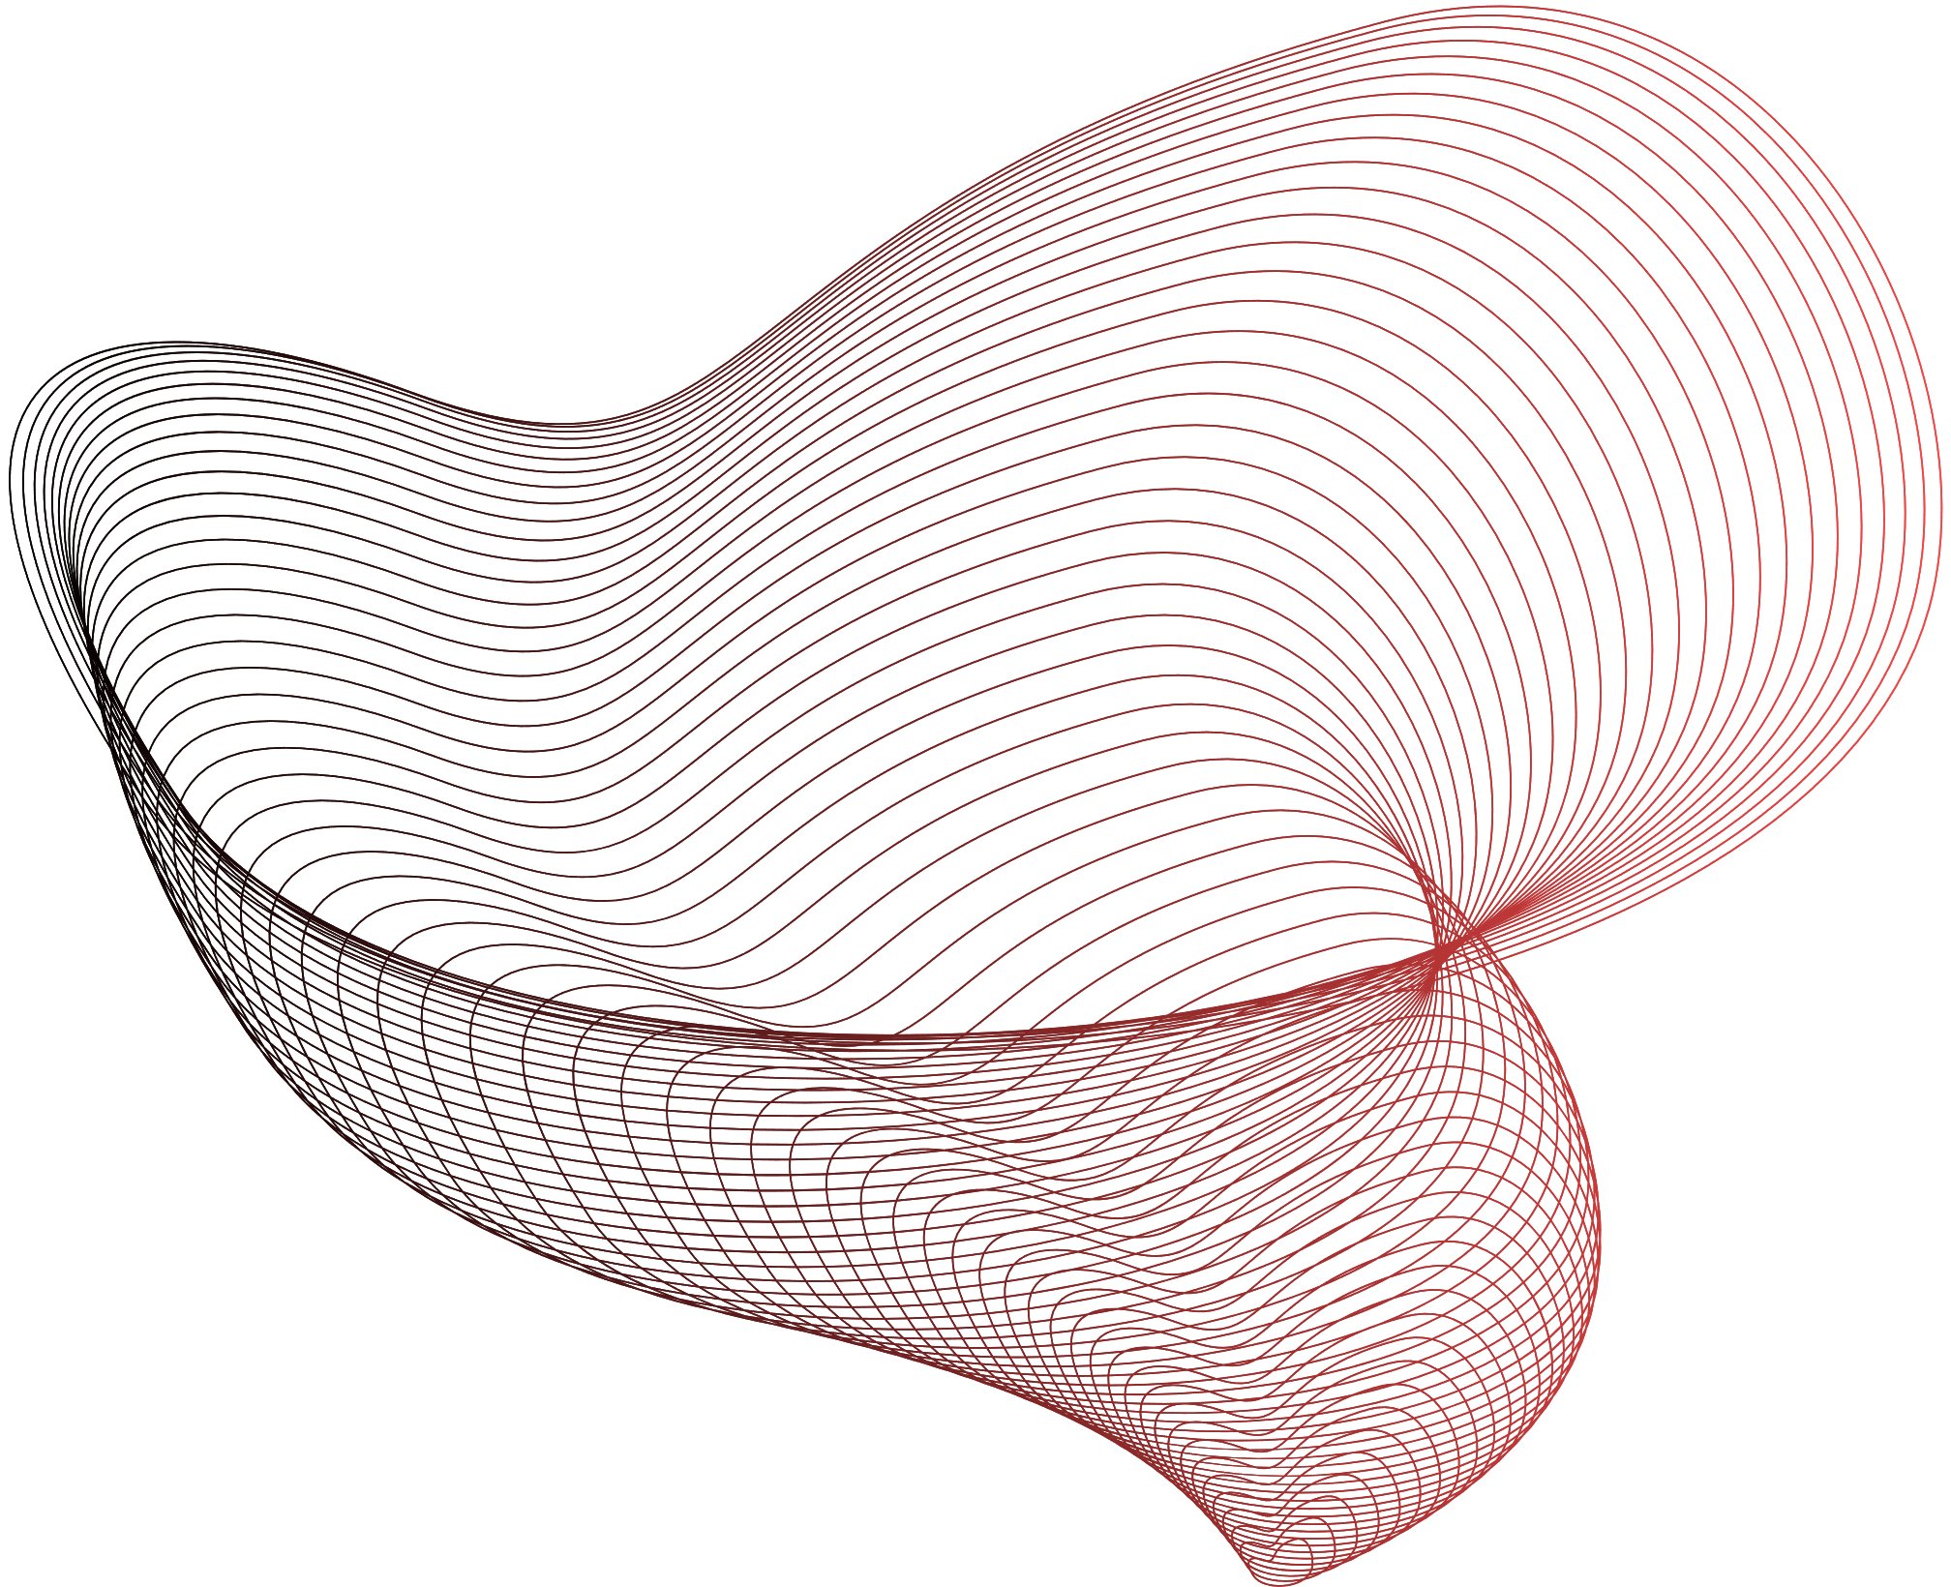

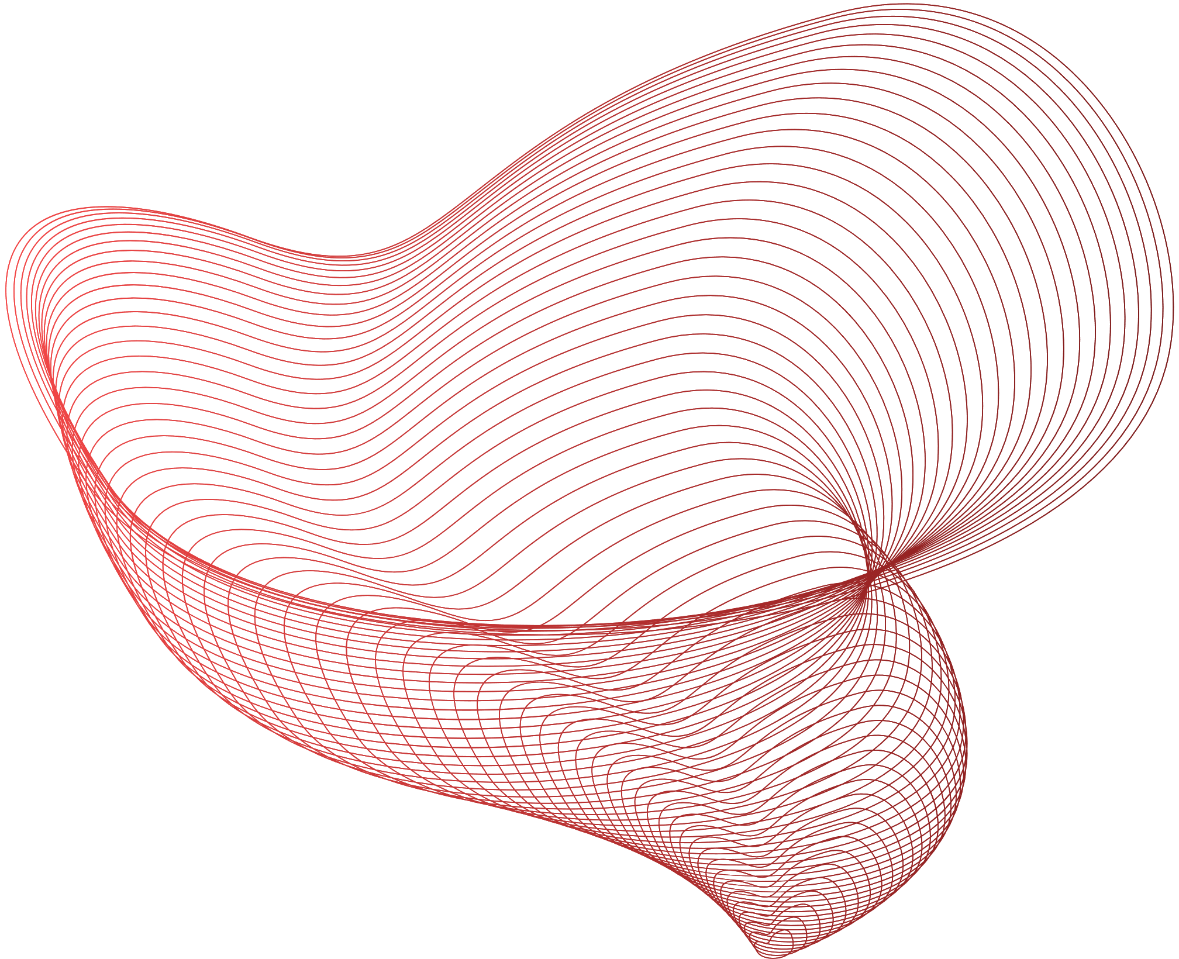

AUGUST-25 -2023
INFINITY CODEWAVE
TEAM: S.A.S
MENTORS from:

Slide 2

INFINITY CodeEWave
INTRODUCTION
TEAM: S.A.S
Back to Agenda

Slide 3
PROBLEM STATEMENT:
Some Physical Addressing that is:
Sustainable
Easy to Fit in for new ones
Interpolation
Computationally Cheap

Slide 4
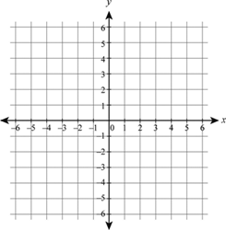

Slide 5
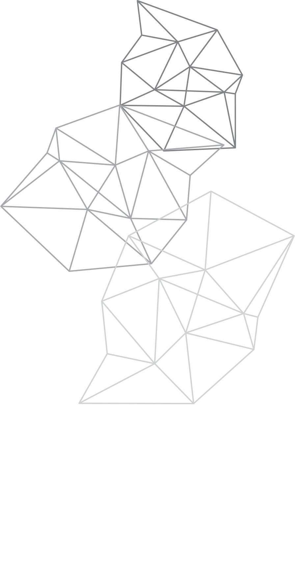
Hierarchical Grid System:
It is a method of dividing a geographic area into nested grids. It involves breaking down a large area into smaller sections, and each section can be further divided. This creates a structured hierarchy that helps organize and manage geographic data effectively.

Slide 6
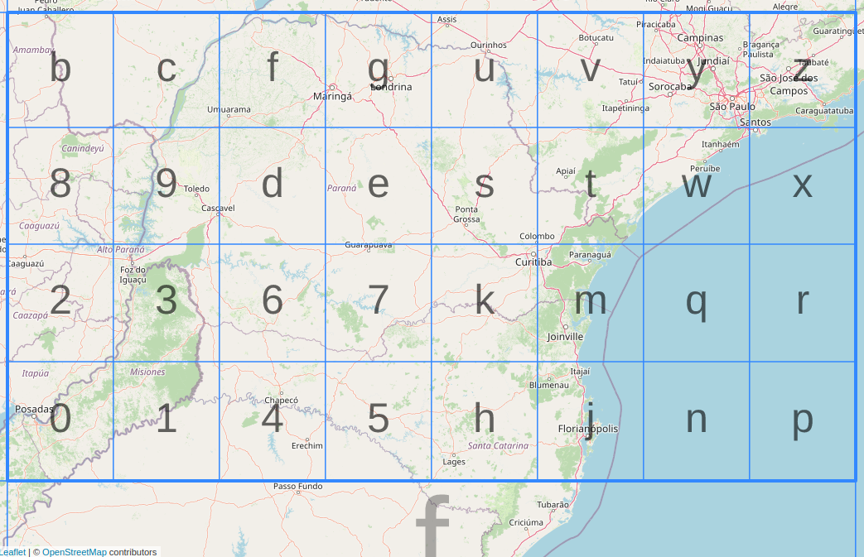

Slide 7
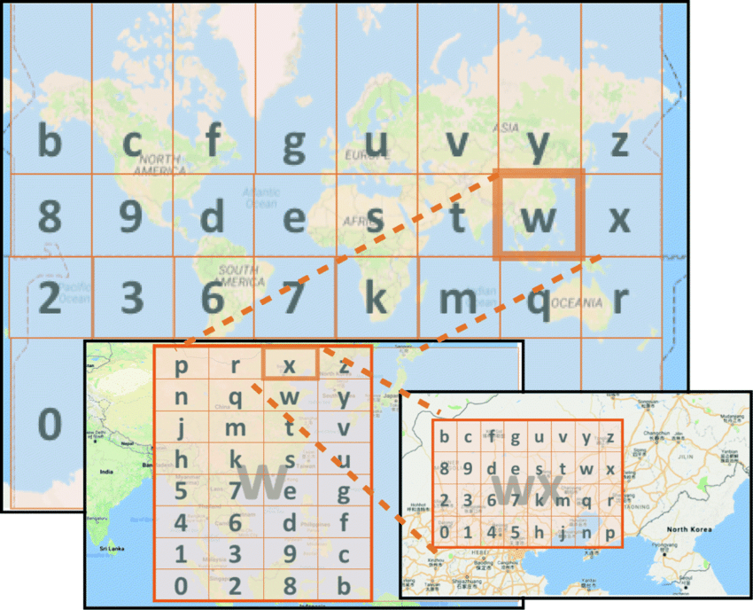
Classic approach:

Slide 8
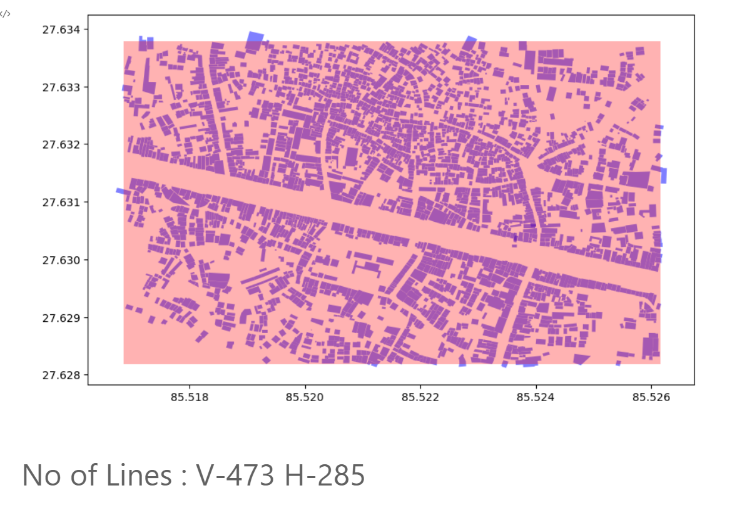

Slide 9
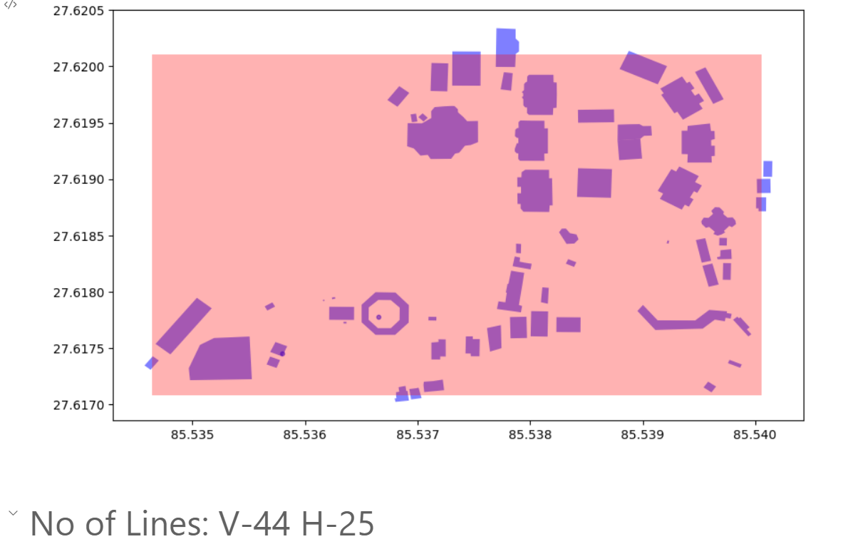

Slide 10
Solution Overview:

Slide 11
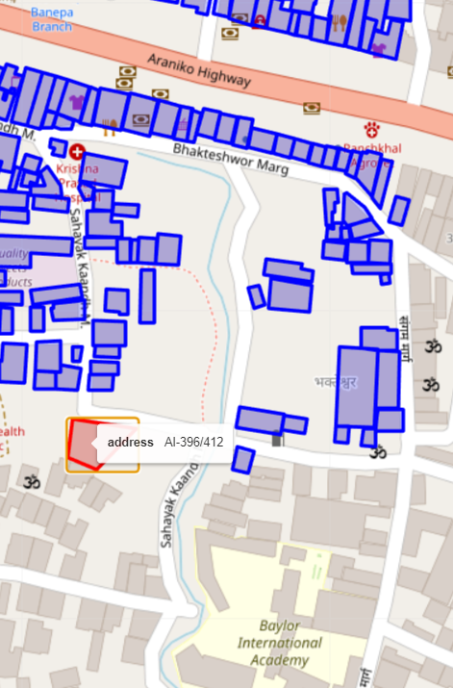
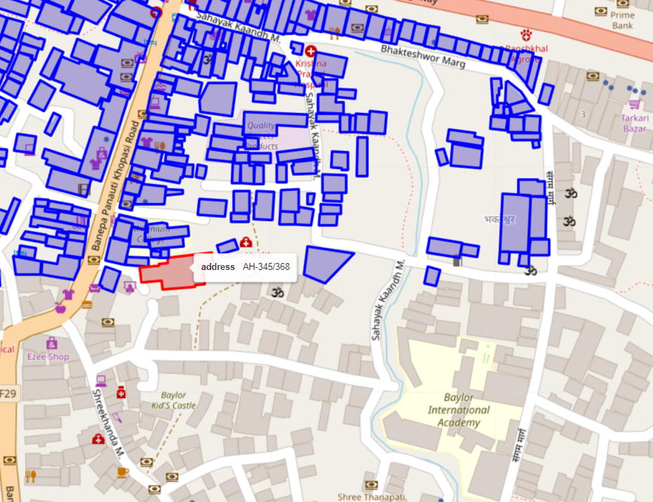

Slide 12
Unique House Names and Identifiers:

Slide 13
Real World impact:

Slide 14
Conclusion

